Slide 1
TeamWorks Travel & Expense Basics
March 30, 2023

Slide 2
Getting Started in Concur
Register in TeamWorks Employee Self Service (ESS)
Log into ConcurSolutions.com with Username and Password
Set up Profile with Mileage Reimbursement Rates-Tier I & Tier II
For trips outside of GA, obtain approved Authorization for Out-of-State Travel form
Directions for these steps and Out-of-State form are on News Across the Crescent in the Travel & Concur Section

Slide 3
Booking Travel in Concur
Travelers can book reservations through their Concur Homepage or by contacting Travel Inc. Consultant Team. Extra fees will apply when booking with Travel Inc.
TRAVEL INC

Slide 4
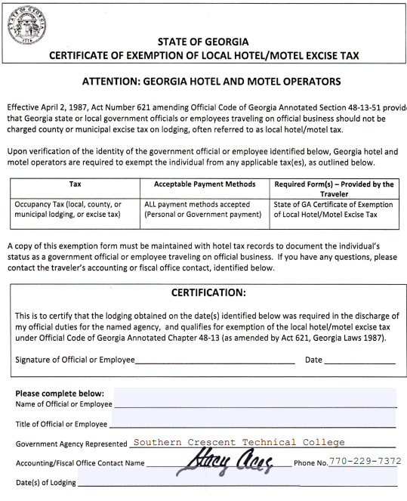
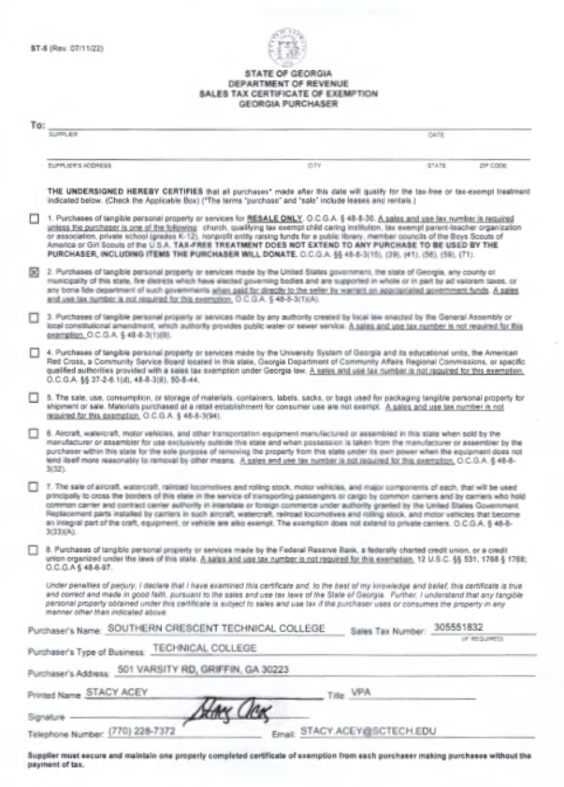
Booking Travel in Concur-Hotels
Travelers are allowed lodging expenses when their destination is more than 50 miles from their residence, AND they will be away more than 12 hours
Make lodging reservations through Concur unless a Conference Hotel with group rates
Select the least expensive option available taking into consideration proximity to the business destination and personal safety
Reserve room with personal credit card unless room is Direct Bill to SCTC
Present both the SCTC Sales Tax Exemption Certificate (ST-5) and the State of Georgia Certificate of Exemption of Local Hotel/Motel Excise Tax at the time of check-in (only for GA hotels)
Keep all receipts for expense reimbursement upload

Slide 5
Booking Travel in Concur-Flights
All flights are billed directly to SCTC-no out-of-pocket payment necessary
Make flight reservation through Concur at least 14 days, but no more than 30 days in advance, when practical
Book the lowest logical airfare, using nonrefundable fares when feasible. If travel is cancelled, ticket can be reused later by the traveler. If a refundable fare must be used, the difference in the cost must not exceed $150.00
Higher class tickets, such as first class, are not reimbursable for domestic flights
The State will only reimburse baggage charges for the 1st piece of luggage unless appropriate business purpose explanation is provided
Baggage charges for excess weight will not be reimbursed unless appropriate business purpose explanation is provided
See State Travel Policy on News Across the Crescent for more details

Slide 6
Booking Travel in Concur-Car Rental
Rental car expenses are billed directly to SCTC-no out of pocket expense.
Travelers should use fleet vehicles when available. If a rental car is necessary, travelers must use the rental suppliers with which the State has mandatory statewide contracts.
Travelers must secure the lowest cost contract rental available at the time of booking.
Approved car rental sizes are Compact, Intermediate, or Full size. Vans may be rented for 4 or more travelers.
Reimbursements will be made for reasonable fuel charges. Rentals should be returned with the same amount of fuel as at pick-up. Travelers must decline any option fuel offerings by rental vendor.
Rentals are covered by the State’s liability policy, so coverage with the rental vendor should be declined. The policy is only in effect while the employee is using the rental for official State business. Personal use of the vehicle, including allowing family and friends to ride in State rented vehicles, is prohibited.
Loss Damage and Collision Damage are also covered by the Statewide Car Rental Vendor Contract.
In the event of an accident while driving a rental vehicle, contact the Risk Management Office at 1-877-656-7475, as well as the rental vendor, for claims handling.
Keep all rental documents and rental fuel receipts to upload to your expense reimbursement report.

Slide 7
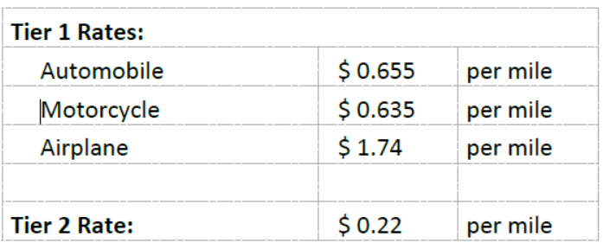
Using a Personal Automobile
Reimbursements for business use of a personally-owned vehicle is calculated per business-use mile, from point of departure to point of arrival, including any way-points and deducting actual commute mileage, as applicable.
Reimbursement rates are set by the State:
Tier I reimbursement - When a college vehicle is requested but unavailable. Must submit Vehicle Reservation Form online prior to travel and submit email from Facilities & Operations declining the request as an attachment to expense report.
Tier II reimbursement - When a college vehicle is available, but a personal vehicle is used.
Current rates for calendar year 2023:

Slide 8
Using a Personal Automobile-continued
Commuting Miles are considered personal mileage and are not reimbursable. The total amount of commuting miles (one-way or round-trip) must be deducted when calculating total mileage reimbursements.
Commuting Miles is defined as the actual mileage travelled between traveler’s Residence and Primary Workstation. If travel begins and/or ends at the Primary Workstation, commuting miles do not need to be deducted.
No deduction for Commuting Miles is required for travel on weekends or holidays.
Tolls, where there is not another reasonable alternative route, and parking charges incurred while on official state business will be reimbursed.
While driving a personal vehicle on state business, the State provides full liability coverage and personal immunity for the traveler for damages and injuries the traveler may cause to others. The State does not provide coverage for damages to personal vehicles, and cost of repairs to personal vehicles are not reimbursable.
The State will not reimburse tickets, parking fines, or violations related to federal and state statutes.
Mileage reimbursement examples can be found in Appendix A of the Statewide Travel Policy.

Slide 9
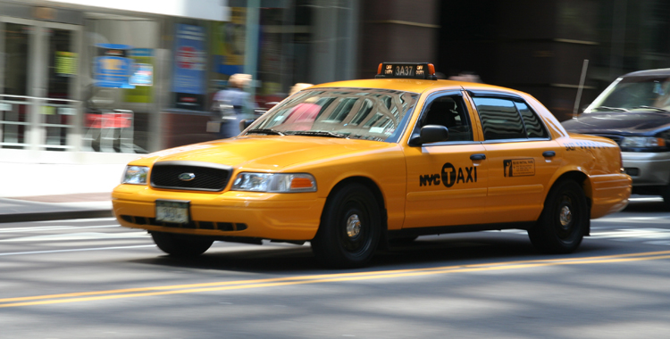
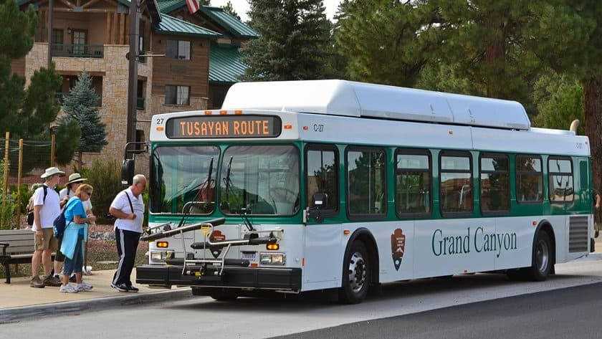
Other Transportation
The State will reimburse for shuttles, rideshare, or taxi fares to and from airports
Fares between business meetings while in travel status are also reimbursable
The State will reimburse tips for shuttles, rideshares, or taxi services, up to 20% of the total cost.
Itemized Receipts are required for other transportation expenses above $25.00
This Photo by Unknown Author is licensed under CC BY-NC-ND
This Photo by Unknown Author is licensed under CC BY-NC-ND
This Photo by Unknown Author is licensed under CC BY-SA-NC

Slide 10
Meals
Reimbursable on a per diem basis (not actual expenses) that covers cost of meals, taxes, and tips on meals. Per Diem expenses do not require receipt to be provided.
In-State Meal Per Diem - The daily rate for travel within the State of GA is $50.00 per day to cover three meals per day.
Breakfast $13.00
Lunch $14.00
Dinner $23.00
Out-of-State Meals Per Diem - The daily rate for other states is found by searching the U.S. General Services Administration website (www.GSA.gov/travel/plan-book/per-diem-rates) for the applicable geographic location of travel.
Incidental travel expenses (fees and tips given to porters, bellhops, hotel staff, etc.) are reimbursed separately from Per Diem Rates for In-State and Out-of-State travel, but are included in International Per Diem Rates.

Slide 11
Meals-Continued
Travelers who are provided meals during their course of travel must deduct the corresponding, applicable meal rate from their per diem reimbursement claim for each meal provided.
Meal adjustments include those provided by hotels, meeting, conferences, or any other source.
If a continental breakfast, lunch, dinner, or reception is offered as part of the travel, and the food/timing is sufficient to serve as a meal, the traveler must reduce the per diem amount by the appropriate allowance amount.
Travelers with medical restrictions should make every effort to have a source providing a meal facilitate their needs. If this is not possible, the traveler is not required to deduct the applicable meal allowance from the per diem. However, the traveler must include a note or other documentation of this exception with their travel expense reimbursement

Slide 12
Meals-Continued
Meal Per Diems during OVERNIGHT TRAVEL – Employees traveling overnight are eligible for 75% of the total per diem on the first and last day of travel. Departure time and arrival time are not considerations for calculating the Meal Per Diem when associated with overnight travel. Any meals provided during the first and last day of overnight travel would be deducted from the reimbursable amount after the 75% is calculated.
Meal Per Diems during NON-OVERNIGHT TRAVEL – Travelers on state business who travel more than 50 miles from their Residence AND their Primary Workstation, AND are away for more than 12 hours, may receive the total eligible per diem allowance for that day, even when there is no overnight lodging. The per diem allowance must still be adjusted for any meals provided. The meal per diem rate will be determined by the location of the last business stop of the day of travel.

Slide 13
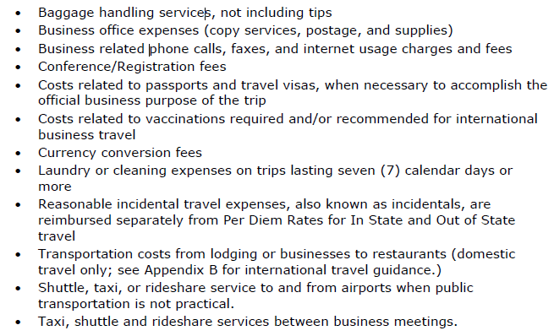
Miscellaneous Reimbursable Expenses
Other reimbursable expenses while on official state business include, but are not limited to, the following:

Slide 14
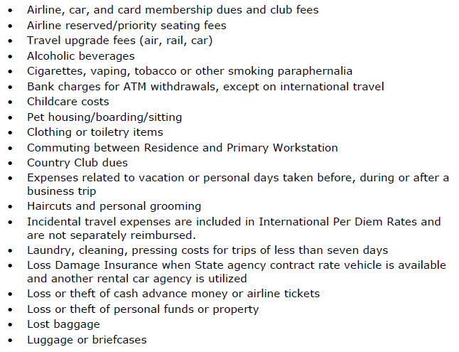
Non-reimbursable Expenses
Include, but are not limited to, the following:

Slide 15
Submitting Expense Reimbursements
Travelers should submit all expenses for reimbursement within 10 days of the completion of the event or trip, but no later than 45 calendar days.
Per IRS regulations, any travel expense reimbursements submitted more than 60 days after the end of the trip become taxable income to the traveler and will be included on their W-9 at year-end.
Each travel expense report submitted costs the college $3.93 (billed through State Accounting). Reports for some expenses, such as mileage, can be submitted on a monthly basis if the traveler anticipates multiple days for mileage expenses per month.

Slide 16
Allocations
Your default allocation for your expense report is the budget from which you receive your payroll.
If your expense needs to come from another budget, you will need to change your allocations in your Concur report.
Put the allocation needed in the comments when creating your report
Allocate your entire report or just certain lines of your expenses
Allocate all of an expense, a certain amount, or a percentage
All of the budget chart fields are required for allocations, so contact the Business Office if you need assistance with the correct department, program, fund source, fund code, project, and class
The $3.93 fee for each Concur expense report submitted will also be charged to budget to which the expenses are allocated

Slide 17
Receipts/Attachments
Itemized receipts with vendor name & address, description of goods/services, and amount paid for each item are required for:
Hotel receipts
Flight records
Rental car records
Receipts for other expenses equal to or above $25.00
Agendas
Approved Out-of-State Travel Authorizations
Vehicle Reservation Request emails stating no vehicle is available (to claim Tier I mileage reimbursement)

Slide 18
See the Statewide Travel Policy for more details and examples

